Slide 1
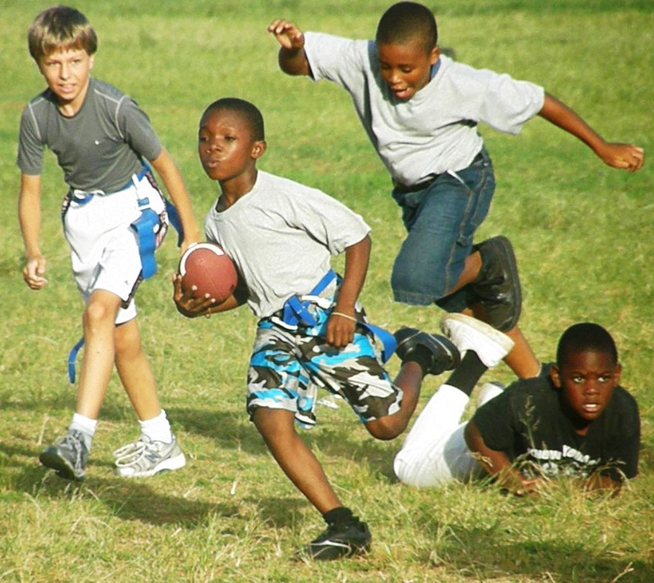
Fluency #6 40 words

Slide 2
Matt and Molly were playing football. They were playing Tim and Jill. The ball was hiked to Molly.
“Throw me the ball!” Yelled Matt.
“What?” asked Molly.
“Throw me the ball. Throw a pass to me!” said Matt. “Right now!”
1

Slide 3
“Do you want me to throw this football to you?” asked Molly.
“Yes,” said Matt. “Do it right now!”
“Why?” asked Molly. “Why do I have to throw you the ball right now? Can’t you wait?”
“No!” yelled Matt loudly.
2

Slide 4
Molly shouted, “Who ever heard of warm ice cream!”
Matt said nothing.
“How did the ice cream get warm?” asked Molly.
Matt said, “You put it on the shelf. Now it’s not ice cream.”
“Well what is it?
“A puddle.”
3

Slide 5
Biff said, “My ball is in the tree. It is stuck there. Please help”
“No,” said Bopper. “There are zebras in trees. They could jump on me. They could eat me.”
“There are no zebras in this tree,” Biff said.
4

Slide 6
Biff and Bopper got a ladder. Biff held the ladder. Bopper climbed up the ladder. They wanted to get Biff’s ball. It was stuck in the tree.
At the top, Bopper saw Biff’s ball. But there was a zebra there!”
5

