Slide 1
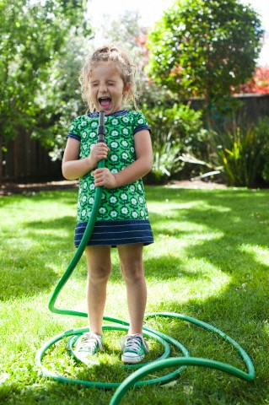
Fluency #1240 words

Slide 2
Pam and Sally were in a deep hole. They had the end of a worm. Part of it was still in the dirt. They were pulling hard. “Pull harder!” yelled Pam.
“I’m pulling as hard as I can,” Sally said.
1

Slide 3
Pam was digging a hole. She said to Sally, “I’m digging this hole because I’m going fishing.”
“Why do you need to dig a hole to go fishing?” asked Sally.
“I’m digging for worms,” said Pam. That’s why I’m digging.
2

Slide 4
Pam and Sally pulled on the worm. They pulled hard. They pulled really hard. Finally the worm came out of the ground. “Wow!” said Sally, “it’s a big one. It is 4 feet long.”
“Yes,” said Pam. And it’s green.”
3

Slide 5
Pam and Sally pulled a big worm from the dirt. It was 4 feet long. It was green. “Wait a minute,” said Sally. “Worms are not green.”
“Oh dear,” said Pam.
“And worms are not 4 feet long,” Sally said.
4

Slide 6
“That’s not a green worm,” Sally said to Pam.
“It’s not?” asked Pam. “Is it a snake?”
“No,” said Sally, “It’s not a snake.”
“Well what is it then?” Pam asked.
“It’s a hose,” Sally said.
“Oh dear,” said Pam.
5

